Slide 1
Checking understanding of perimeter
Perimeter, area and volume

Slide 2
how to use Oak lessons

Slide 3
I can find the perimeter of many polygons or compound shapes.

Slide 4
The perimeter is the distance around a 2D shape.
A polygon is a flat (2D), closed figure made up of straight line segments.
A compound shape is a shape created using two or more basic shapes. A composite shape is an alternative term for a compound shape.

Slide 5

Checking understanding of perimeter
Understanding perimeter
Finding efficient methods to calculate perimeter
Finding missing lengths when the perimeter is known

Slide 6
Understanding perimeter
Perimeter is a length that wraps around a 2D space.
The rectangle below represents a field that is surrounded by a wall.
Which could be found by calculating the perimeter of the field: the total amount of grass or the total length of wall?
The perimeter of the field is the total length of the wall.
120 m
90 m
90 m
120 m

Slide 7
Understanding perimeter
Perimeter is a length that wraps around a 2D space.
The rectangle below represents a field that is surrounded by a wall.
Which could be found by calculating the perimeter of the field: the total amount of grass or the total length of wall?
The perimeter of the field is the total length of the wall.
120 m
perimeter = 420 m
90 m
90 m
120 m
90 m
120 m
420 m

Slide 8
Understanding perimeter
The perimeter is the distance around a 2D shape.
Perimeter is a length and so it can be measured with units of length (e.g. centimetres, inches).
What other units could be used to measure perimeter?
millimetres
feet
metres
yards
kilometres
miles

Slide 9




Understanding perimeter
The perimeter can be found by summing the lengths of the sides.
Who has correctly calculated the perimeter of the rectangle?
5 cm
Jun’s working:
8 + 5 = 13 cm
Jun has not included all of the sides.
8 cm
8 cm
Sofia’s working:
8 + 5 + 8 + 5 = 26 cm
5 cm

Slide 10

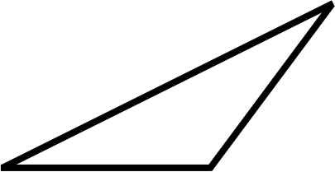

Understanding perimeter
The perimeter can be found by summing the lengths of the sides.
Who has correctly calculated the perimeter of the triangle?
Alex’s working:
8 + 5 + 6 = 19 cm
8 cm
4 cm
6 cm
Sam’s working:
5 cm
8 +
5 +
6 +
4
= 23 cm
Sam has included a length that is not one of the sides.

Slide 11
Understanding perimeter
The rectangle is made out of square tiles. What is the perimeter of the rectangle?
2 m
6 m
1 m
8 m
1 m
12 m

Slide 12
Understanding perimeter
Which shape has a perimeter of 16 cm?
6 cm
3 cm
10 cm
5 cm
2 cm
5 cm
6 cm
3 cm

Slide 13
Understanding perimeter
1) Find the perimeter of each shape.
a)
b)
c)
3 m
5 m
4 m
5 m
4 m
5 m
3 m
1 cm
3 m
1 cm

Slide 14
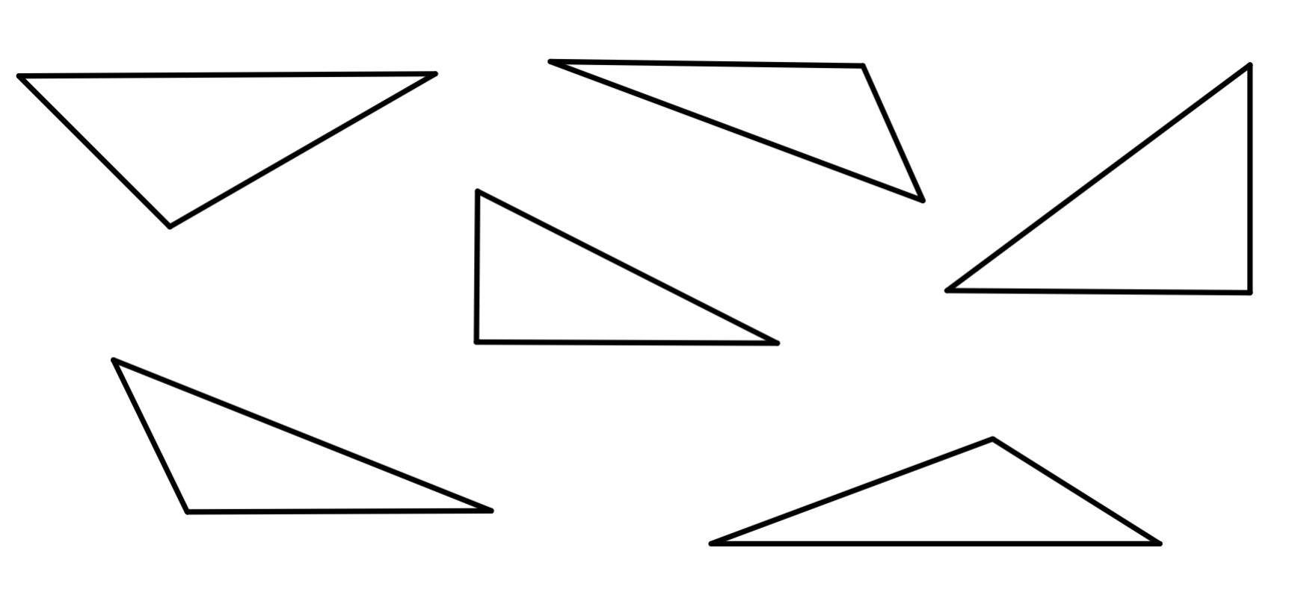
Understanding perimeter
2) Tick the triangles that contain enough information to calculate their perimeter by summing the given lengths. All lengths are given in centimetres.
4
5
B
2
5
A
5
3
2.5
D
4
2
4
C
3
4
4
F
2
3
E
5

Slide 15
Understanding perimeter
1) Find the perimeter of each shape.
a)
b)
c)
3 m
5 m
4 m
5 m
4 m
5 m
3 m
1 cm
3 m
1 cm
12 m
16 m
18 cm

Slide 16
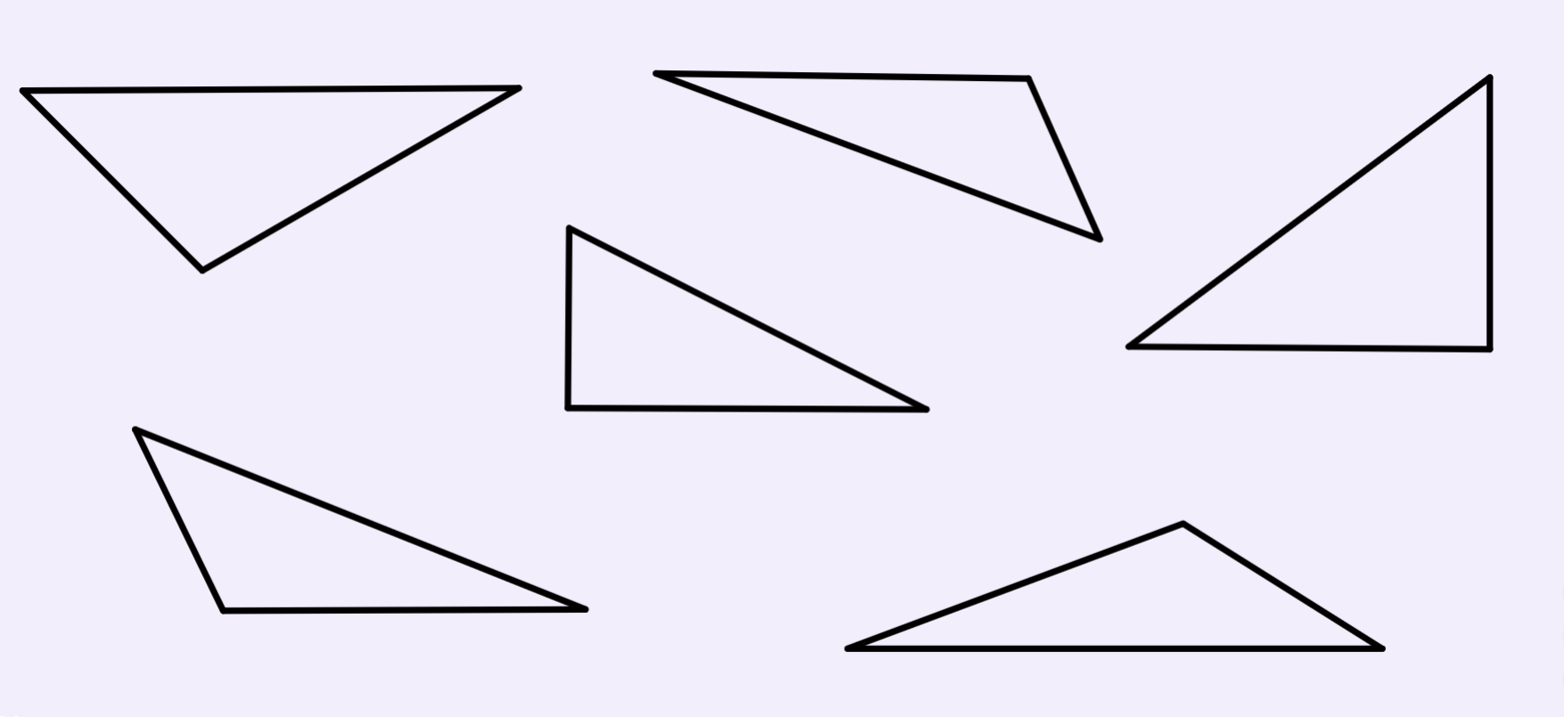
Understanding perimeter
2) Tick the triangles that contain enough information to calculate their perimeter by summing the given lengths. All lengths are given in centimetres.
4
5
B
2
5
A
5
3
2.5
D
4
2
4
C
3
4
4
F
2
3
E
5

Slide 17
Checking understanding of perimeter
Understanding perimeter
Finding efficient methods to calculate perimeter
Finding missing lengths when the perimeter is known

Slide 18
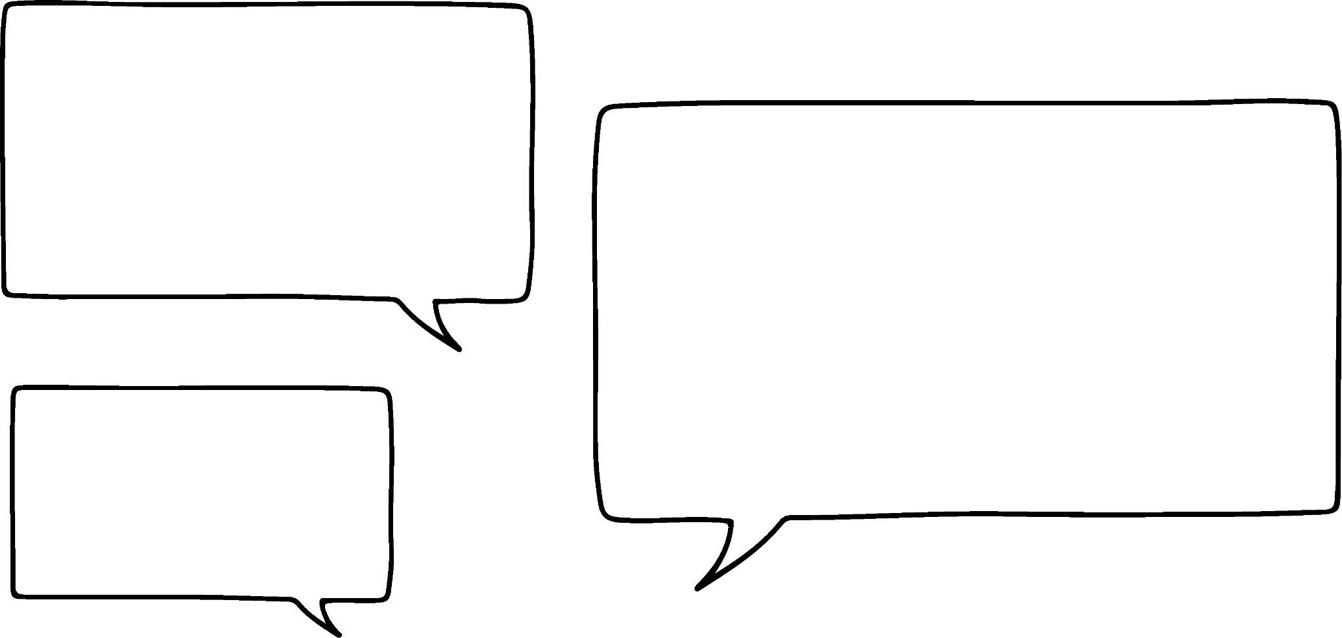
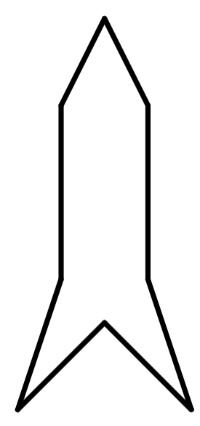

Finding efficient methods to calculate perimeter
Aisha has found the perimeter of the shape.
I started at the top of the shape and summed each length in order.
2 m
2 m
5 m
5 m
2 + 5 + 4 + 3 + 3 + 4 + 5 + 2 = 28 m
4 m
4 m
3 m
3 m
Is there a more efficient way to do this?

Slide 19

Finding efficient methods to calculate perimeter
Jacob has found the perimeter of the shape in a different way.
Each length appears twice. So I double each length before summing them.
2 m
2 m
5 m
5 m
2 × 2 + 2 × 5 + 2 × 4 + 2 × 3 = 4 + 10 + 8 + 6 = 28 m
4 m
4 m
3 m
3 m
Is there a more efficient way to do this?

Slide 20

Finding efficient methods to calculate perimeter
Izzy has found the perimeter of the shape in a different way.
The lengths are the same on each side. So I summed the lengths on the left and then multiplied by 2.
2 m
5 m
2 × (2 + 5 + 4 + 3) = 2 × 14 = 28 m
4 m
3 m

Slide 21
Finding efficient methods to calculate perimeter
The perimeter for shapes with symmetry or repeating patterns can be calculated using different methods.
2 + 5 + 4 + 3 + 3 + 4 + 5 + 2
2 m
Aisha
5 m
2 × 2 + 2 × 5 + 2 × 4 + 2 × 3
Jacob
4 m
2 × (2 + 5 + 4 + 3)
Izzy
3 m
Whose method seems the most efficient?

Slide 22
Finding efficient methods to calculate perimeter
Sides which have the same markings have equal lengths. Find the perimeter.
Method 1:
10 mm
10 mm
10 + 10 + 10 + 10 + 10
= 50 mm
Method 2:
10 mm
10 mm
5 × 10
= 50 mm
10 mm
Which method seems more efficient?

Slide 23
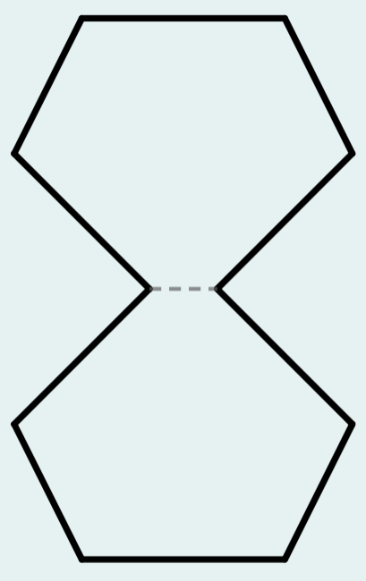
Finding efficient methods to calculate perimeter
The dashed line represents a mirror line. What is the perimeter of the shape?
5 cm
19 cm
3 cm
3 cm
38 cm
4 cm
4 cm
40 cm

Slide 24

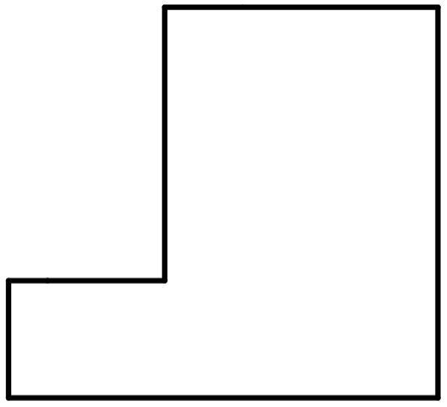
Finding efficient methods to calculate perimeter
Andeep starts with a rectangle, with all lengths in centimetres.
He cuts a rectangle out to make a composite rectilinear shape.
8
10
10
10
8
8
How does this affect the perimeter of the shape?

Slide 25
Finding efficient methods to calculate perimeter
The unknown vertical lengths on the composite shape sum to the total height of the shape.
a
a
10
10
10
b
a + b = 10

Slide 26
Finding efficient methods to calculate perimeter
The unknown horizontal lengths on the composite shape sum to the total width of the shape.
8
d
c
d
8
8
c + d = 8

Slide 27
Finding efficient methods to calculate perimeter
The two shapes have equal perimeters.
8
10
10
10
8
8
perimeter = 2 × (10 + 8) = 36 cm
perimeter = 2 × (10 + 8) = 36 cm

Slide 28
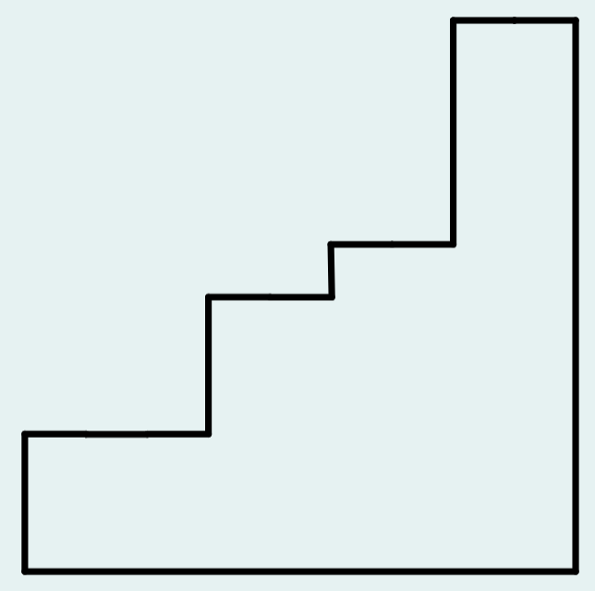
Finding efficient methods to calculate perimeter
Fill in the blank.
a cm
a + b + c + d =
50
b cm
50 cm
c cm
d cm
40 cm

Slide 29

Finding efficient methods to calculate perimeter
Which shape has the same perimeter as the rectangle?
a
b
a
b
c
a
a
a
b
b
b
Some of the vertical lengths overlap with one another.
One of the lengths is diagonal.

Slide 30
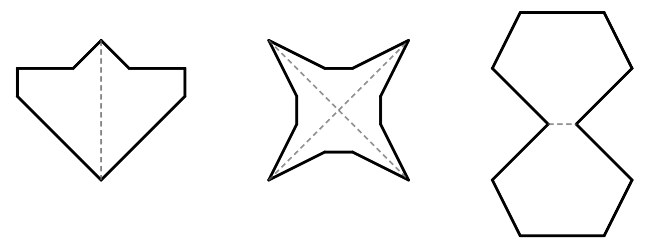
Finding efficient methods to calculate perimeter
1) The shapes were formed by reflecting line segments over the dashed mirror lines. Find the perimeter of each shape.
a)
1 m
b)
5 cm
5 cm
2 m
1 m
4 m
2 cm
2) Find the perimeter of each shape.
a)
b)
c)
11 mm
12 m
5 cm

Slide 31
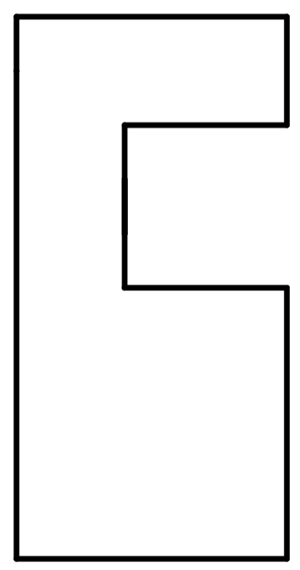
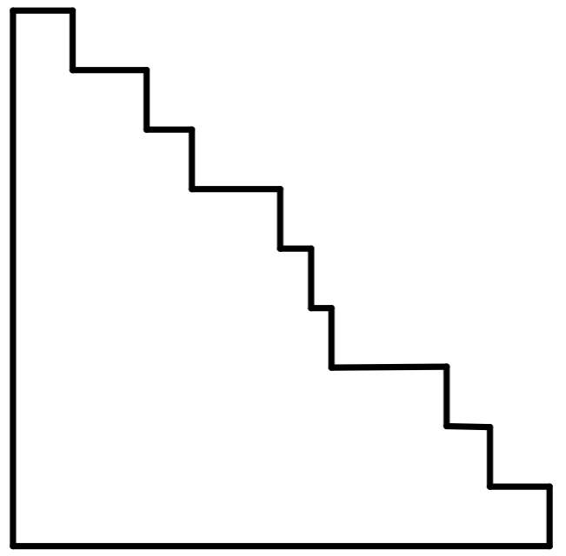
Finding efficient methods to calculate perimeter
3) Find the perimeter of each composite rectilinear shape. All lengths are given in metres.
a)
b)
3
6
4
11
5
2
9

Slide 32
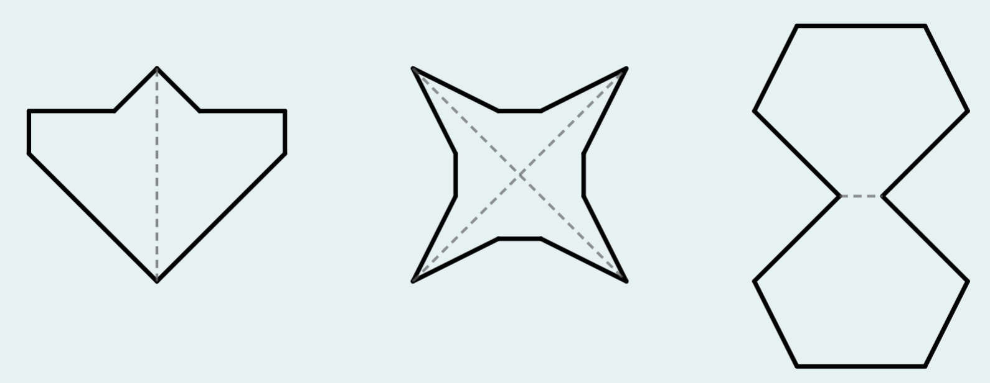
Finding efficient methods to calculate perimeter
1) The shapes were formed by reflecting line segments over the dashed mirror lines. Find the perimeter of each shape.
a)
1 m
b)
5 cm
5 cm
2 m
1 m
4 m
P = 16 m
P = 48 cm
2 cm
2) Find the perimeter of each shape.
a)
b)
c)
11 mm
12 m
5 cm
P = 36 m
P = 20 cm
P = 66 mm

Slide 33
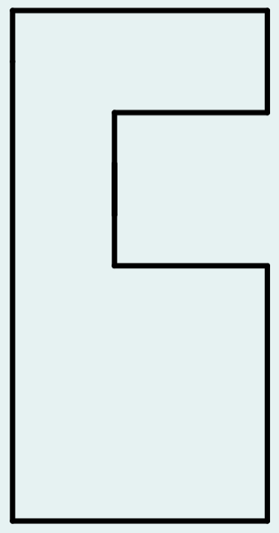
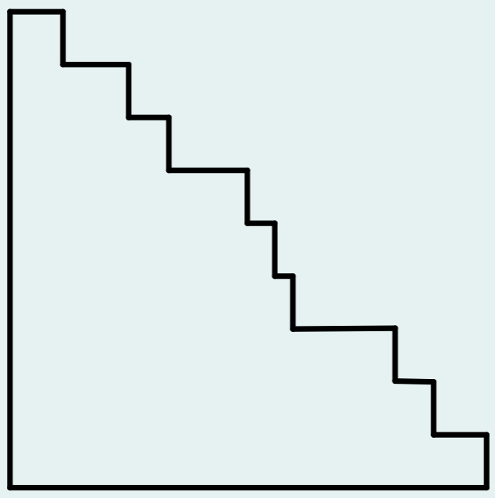
Finding efficient methods to calculate perimeter
3) Find the perimeter of each composite rectilinear shape. All lengths are given in metres.
a)
b)
3
6
4
11
5
2
P = 40 m
9
P = 40 m

Slide 34
Checking understanding of perimeter
Understanding perimeter
Finding efficient methods to calculate perimeter
Finding missing lengths when the perimeter is known

Slide 35
Finding missing lengths when the perimeter is known
The perimeter of the shape is 18 cm. Find the missing length.
8 + 4 + a = 18
12 + a = 18
8 cm
4 cm
a = 18 − 12
a = 6
cm
a

Slide 36
Finding missing lengths when the perimeter is known
The perimeter of the shape is 18 cm. Find the missing length.
a + a + a = 18
3a = 18
3a ÷ 3 = 18 ÷ 3
a = 6
cm
a

Slide 37
Finding missing lengths when the perimeter is known
The perimeter of the shape is 18 cm. Find the missing length.
a + 4 + a + 4 = 18
2a + 8 = 18
4 cm
2a = 10
a = 5
cm
a

Slide 38
Finding missing lengths when the perimeter is known
The perimeter of each shape is 20 m.
In which shapes is the missing length 4 m?
9 m
8 m
7 m
a
c
b

Slide 39
Finding missing lengths when the perimeter is known
1) The perimeter of each shape is 24 m. Find the value of each of the unknowns.
a)
4 m
b)
c)
b m
9 m
7 m
7 m
c m
a m
a =
b =
c =
d)
e)
e m
f)
f m
10 m
8 m
6 m
5 m
5 m
d m
d =
e =
f =

Slide 40
Finding missing lengths when the perimeter is known
1) The perimeter of each shape is 24 m. Find the value of each of the unknowns.
a)
4 m
b)
c)
b m
9 m
7 m
7 m
c m
a m
a =
6
b =
4
c =
6
d)
e)
e m
f)
f m
10 m
8 m
6 m
5 m
5 m
d m
d =
7
e =
f =
1
4

Slide 41
Checking understanding of perimeter
The perimeter is the distance around a 2D shape.
The perimeter of any polygon or compound shape made of polygons can be found by summing the lengths of the sides.
Some methods for finding perimeters are more efficient than others.
Knowing the perimeter can sometimes enable you to find missing lengths.

Slide 42

© Oak National Academy 2023.
Produced in partnership with Mathematics in Education and Industry.
Licensed on the Open Government Licence v3.0, except where otherwise stated. See Oak terms and conditions.

